Slide 1
Impact of lockdown on COVID-19 in England
Nick Davies, Rosanna Barnard, Chris Jarvis, John Edmunds
LSHTM

Slide 2
Outline
Results: Effect of Alert Level on mobility, as measured by Google
Results: Model fit to current epidemic data
Comparison of Welsh “firebreak” & Northern Irish “circuit-breaker” lockdowns
Results: Projected impact of Northern Ireland-strength lockdown (with and without school closures)
Results: Projected impact of Wales-strength lockdown (with and without school closures)
Results: Cumulative deaths in England for different scenarios
Limitations
Conclusions
Methods
Appendices

Slide 3
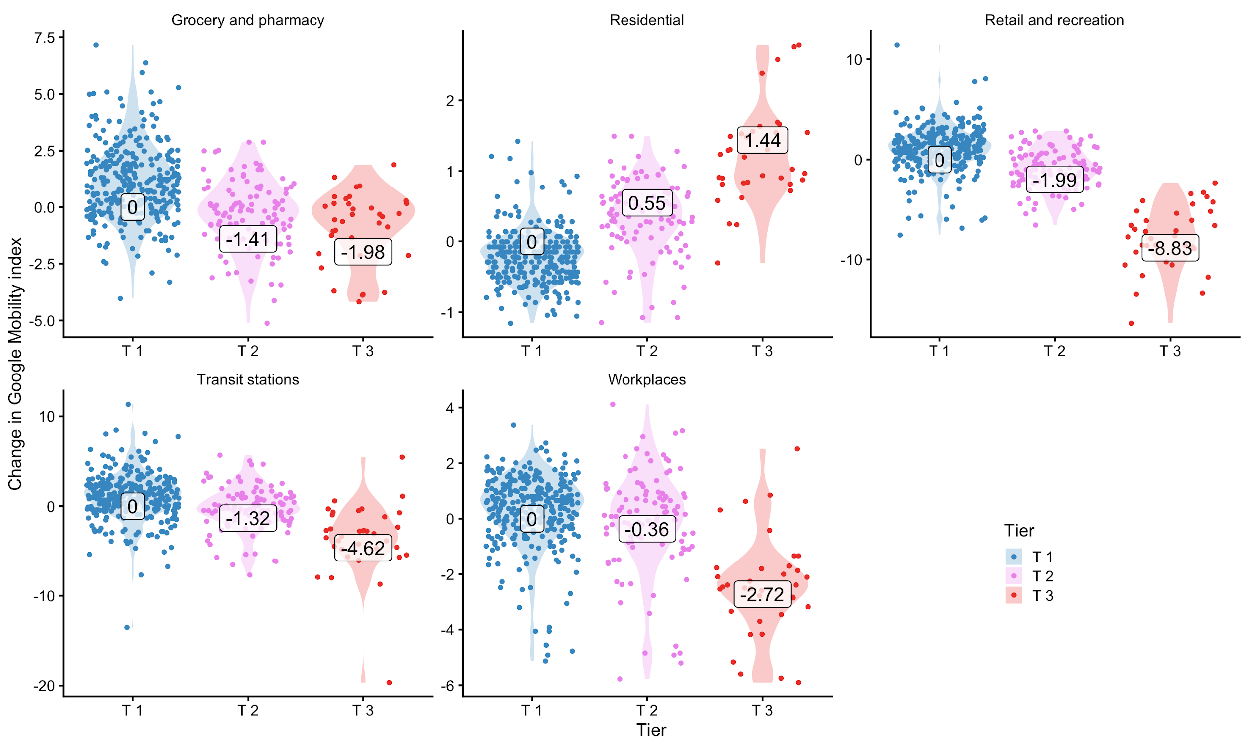
Effect of Alert Level on mobility, as measured by Google
Highlighted numbers show the % change in visits relative to tier 1.

Slide 4
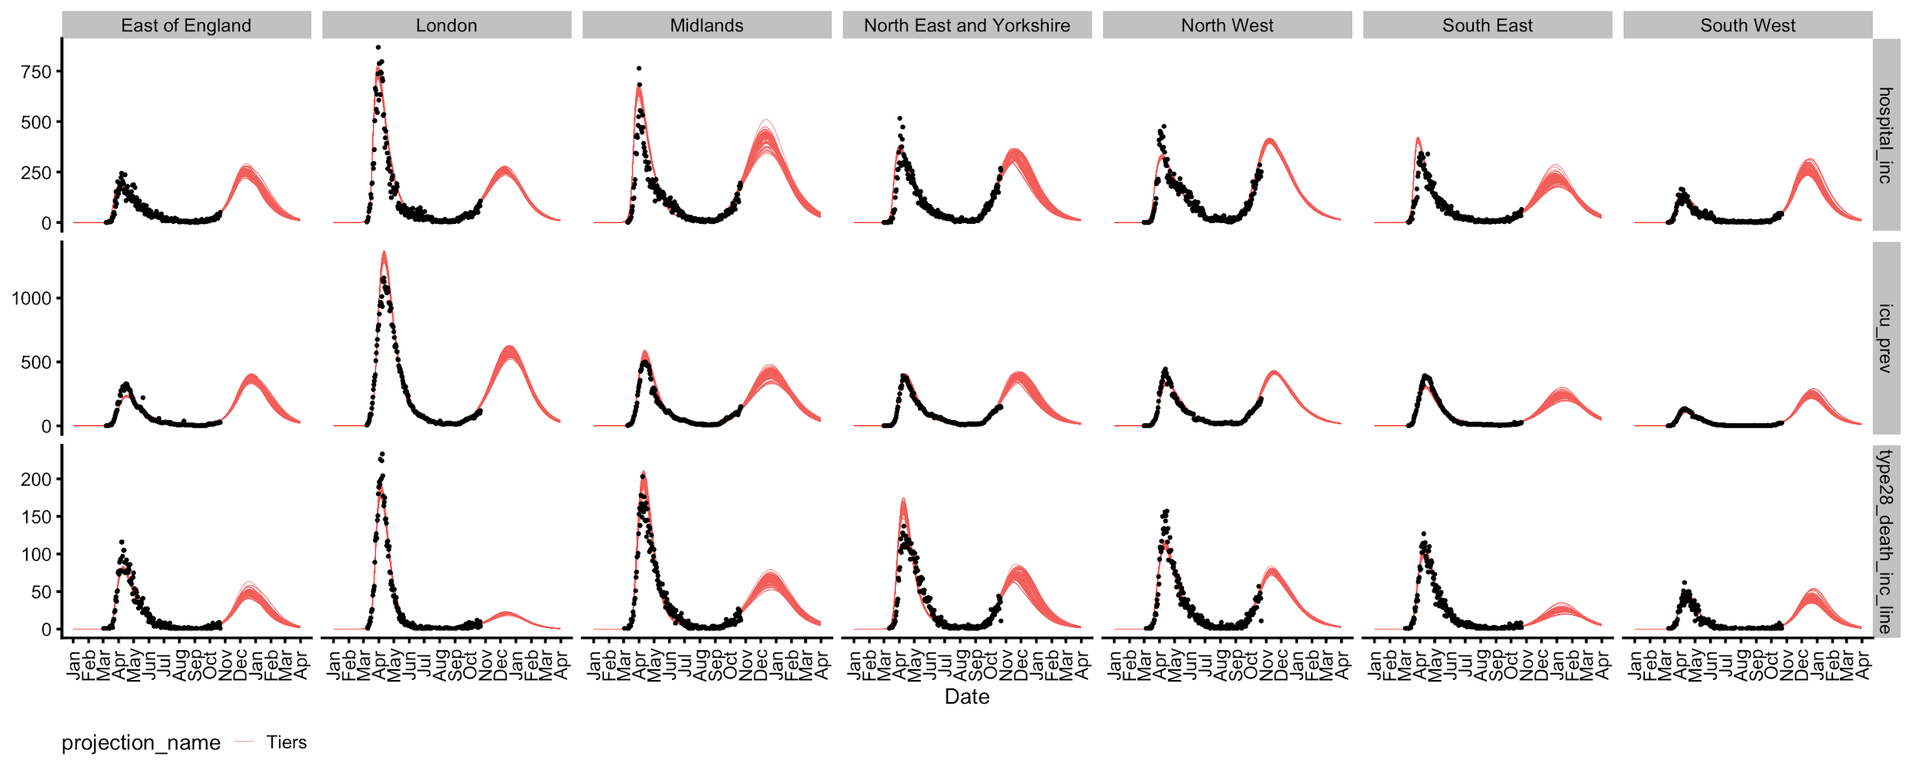
LSHTM model fit to current epidemic data (black dots), with projections (red lines) by NHS England region

Slide 5
Comparison of Welsh “firebreak” & Northern Irish “circuit-breaker” lockdowns
Northern Ireland: two-household bubbles and overnight stays within bubbles allowed
Wales: no indoor or outdoor gatherings with other households allowed
Greater restrictions for non-essential retail, leisure, hospitality and tourism in Wales
Scenarios modelled here:
Northern Ireland strength lockdown for 4 weeks, starting on Nov 2nd, based on an analysis of the impact of the NI lockdown on mobility as measured by Google
Wales strength lockdown based on impact of lockdown on mobility in Wales, starting on Nov 2nd for 4 weeks.
Both of the above are modelled with / without school closure.

Slide 6
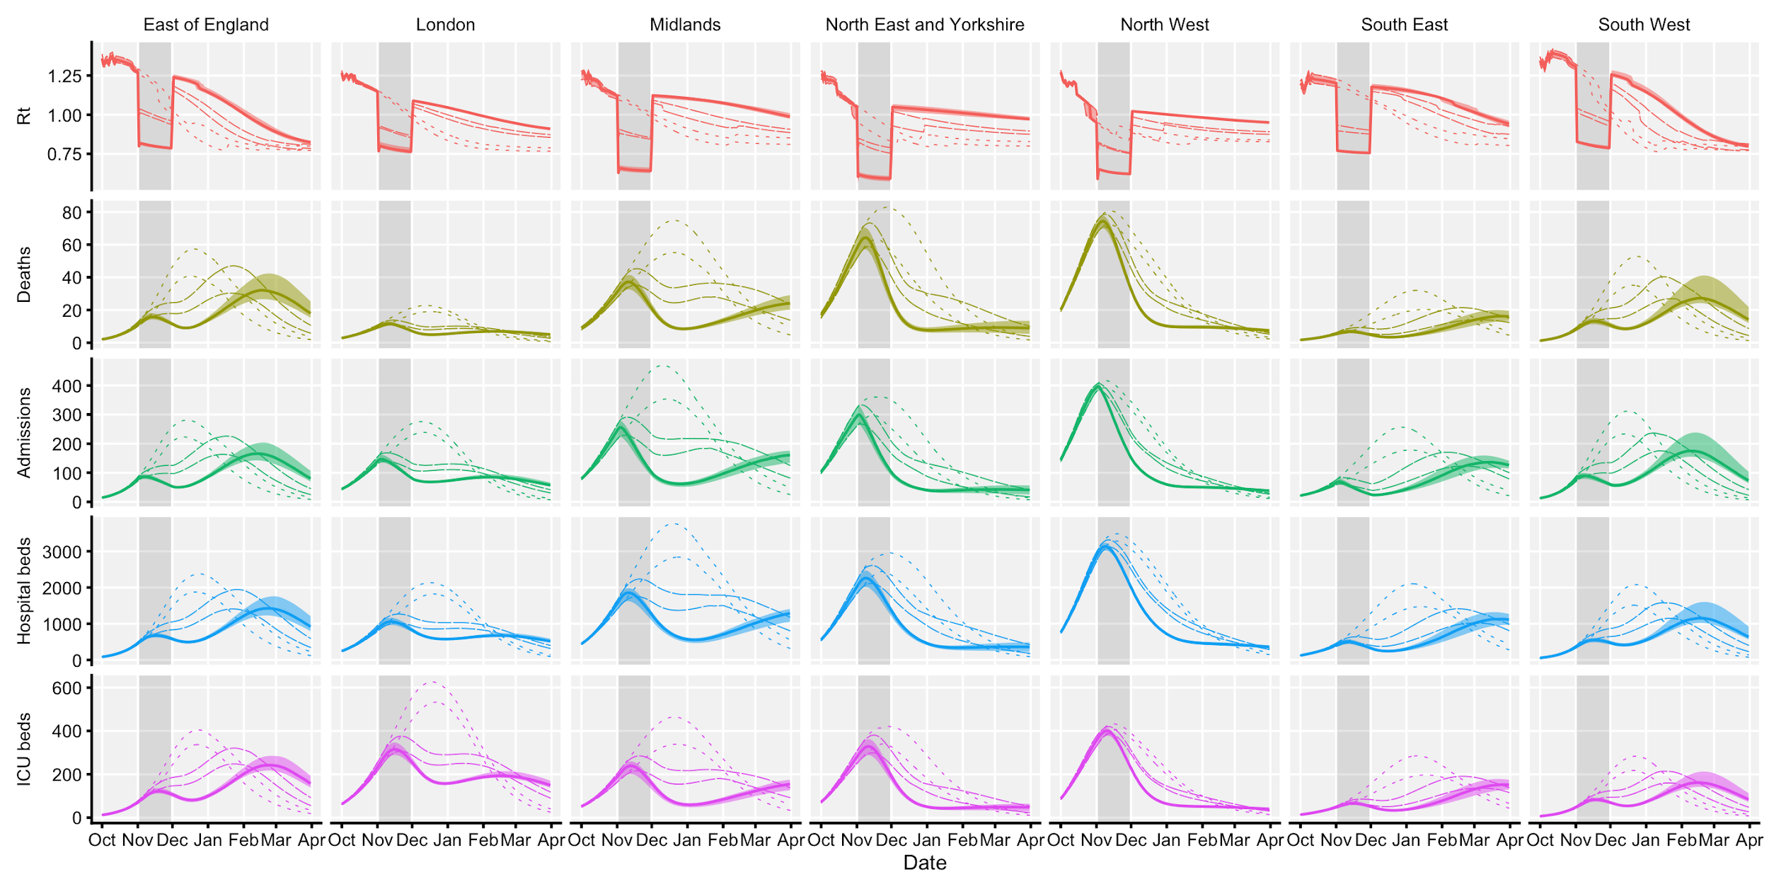
….. Tiers only
– – – Lockdown, schools open
——– Lockdown, schools closed
Projected impact of Northern Ireland strength lockdown in England

Slide 7
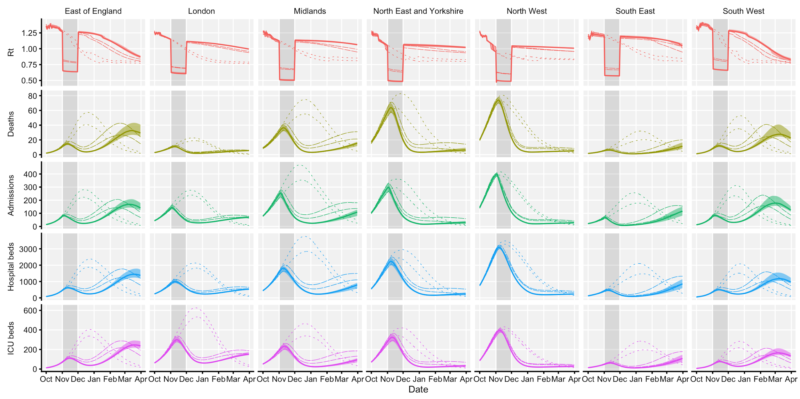
….. Tiers only
– – – Lockdown, schools open
——– Lockdown, schools closed
Projected impact of Wales strength lockdown in England

Slide 8
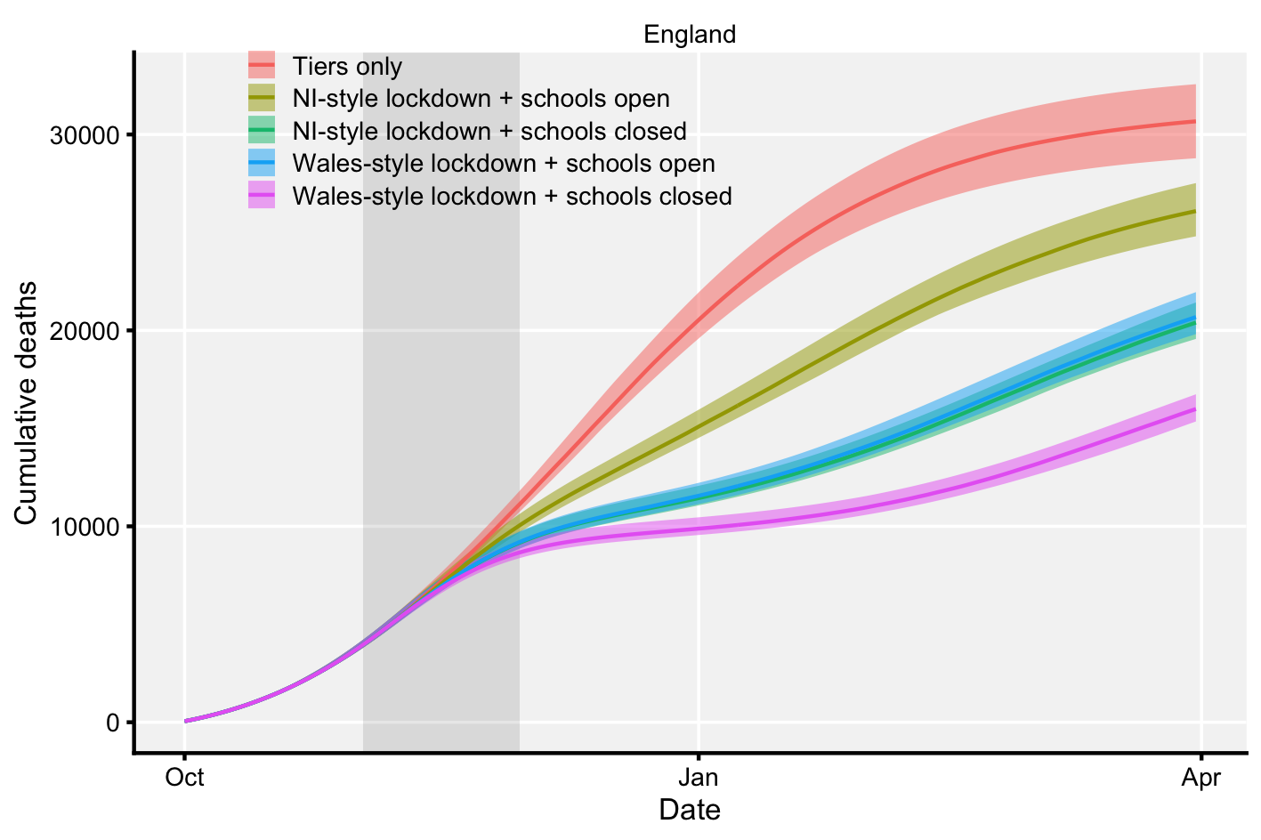
Cumulative deaths in England for different scenarios
Because projections go to the end of March, scenarios appear more similar for total deaths because of a “catch-up” effect.
If a vaccine becomes available earlier than March, the relative benefit of lockdown would be greater.

Slide 9
Limitations
In comparison to other SPI-M groups, our model is more optimistic on the trajectory of the epidemic under a “status quo” scenario (slide 11).
We are also more pessimistic on the impact of school closures compared to other groups: this is because we assume children are less susceptible to infection, which however has been borne out by household-based contact tracing studies.

Slide 10
Conclusions
Tier system only results in highest cumulative deaths (Slide 8)
Wales style lockdown reduces impact on health services and deaths more than Northern Ireland style lockdown (Slides 6-8)
School closure has a significant additional impact (Slide 6-8)
Effect of lockdown on deaths becomes more apparent after the lockdown has finished (Slide 8)
In highest incidence tier 3 areas, we see a smaller effect of lockdown. (Slide 6-7)

Slide 11
Full results: Tier system only
All figures are from 1st Oct 2020 to 31st March 2021
↓all England↓ ↓↓↓ NHS England regions ↓↓↓
indicator | England | East of England | London | Midlands | North East and Yorkshire | North West | South East | South West
Admissions | 189,000 (183,000 - 195,000) | 20,400 (19,000 - 22,300) | 22,900 (22,200 - 23,800) | 42,000 (38,300 - 44,000) | 28,600 (25,900 - 31,500) | 33,800 (32,700 - 34,800) | 21,200 (19,200 - 23,300) | 19,800 (18,400 - 22,900)
Deaths | 30,700 (29,100 - 32,300) | 3,830 (3,460 - 4,420) | 1,860 (1,760 - 1,960) | 6,400 (5,810 - 7,280) | 6,150 (5,350 - 7,290) | 6,350 (6,060 - 6,660) | 2,530 (2,320 - 2,840) | 3,020 (2,820 - 3,900)
Peak ICU (rel. W1) | 74% (71 - 78%) | 156% (147 - 172%) | 43% (41 - 47%) | 76% (63 - 82%) | 101% (90 - 109%) | 125% (121 - 128%) | 79% (67 - 91%) | 211% (193 - 240%)
Peak ICU requirement | 2,380 (2,300 - 2,500) | 361 (341 - 399) | 575 (539 - 625) | 421 (350 - 454) | 389 (348 - 418) | 421 (408 - 430) | 240 (202 - 277) | 242 (221 - 275)
Weeks in Tier 2 | 12 (11 - 13) | 12 (8 - 12) | 16 (16 - 16) | 16 (16 - 16) | 12 (7 - 12) | 10 (7 - 10) | 16 (16 - 16) | 7 (7 - 8)
Weeks in Tier 3 | 3 (2 - 4) | 4 (4 - 8) | 0 (0 - 0) | 0 (0 - 0) | 0 (0 - 4) | 4 (4 - 4) | 0 (0 - 0) | 8 (8 - 8)
Weeks in lockdown | 0 (0 - 0) | 0 (0 - 0) | 0 (0 - 0) | 0 (0 - 0) | 0 (0 - 0) | 0 (0 - 0) | 0 (0 - 0) | 0 (0 - 0)
Weeks of high ICU occupancy | 10 (10 - 10) | 14 (13 - 15) | 0 (0 - 0) | 10 (9 - 11) | 12 (10 - 12) | 13 (13 - 13) | 11 (9 - 12) | 15 (14 - 15)
← total COVID hospital admissions
← total COVID deaths (within 28 days of positive test)
← peak ICU requirement for COVID patients, relative to peak occupancy in first wave
← peak ICU requirement for COVID patients, in number of beds needed
← weeks spent in tier 2, tier 3, or lockdown
← number of weeks during which ICU requirement is 50% or greater than peak in first wave
Note: Our model produces results at the level of NHS England regions, not at individual local authorities. This means that indicators for the number of weeks spent in Tier 2 / Tier 3 should be taken as approximate, and interpreted as an average across the whole NHS England region, not the number of weeks that any particular local authority spends in Tier 2 / 3.

Slide 12
Full results: Tier system only
All figures are from 1st Oct 2020 to 31st March 2021
indicator | England | East of England | London | Midlands | North East and Yorkshire | North West | South East | South West
Admissions | 189,000 (183,000 - 195,000) | 20,400 (19,000 - 22,300) | 22,900 (22,200 - 23,800) | 42,000 (38,300 - 44,000) | 28,600 (25,900 - 31,500) | 33,800 (32,700 - 34,800) | 21,200 (19,200 - 23,300) | 19,800 (18,400 - 22,900)
Deaths | 30,700 (29,100 - 32,300) | 3,830 (3,460 - 4,420) | 1,860 (1,760 - 1,960) | 6,400 (5,810 - 7,280) | 6,150 (5,350 - 7,290) | 6,350 (6,060 - 6,660) | 2,530 (2,320 - 2,840) | 3,020 (2,820 - 3,900)
Peak ICU (rel. W1) | 74% (71 - 78%) | 156% (147 - 172%) | 43% (41 - 47%) | 76% (63 - 82%) | 101% (90 - 109%) | 125% (121 - 128%) | 79% (67 - 91%) | 211% (193 - 240%)
Peak ICU requirement | 2,380 (2,300 - 2,500) | 361 (341 - 399) | 575 (539 - 625) | 421 (350 - 454) | 389 (348 - 418) | 421 (408 - 430) | 240 (202 - 277) | 242 (221 - 275)
Weeks in Tier 2 | 12 (11 - 13) | 12 (8 - 12) | 16 (16 - 16) | 16 (16 - 16) | 12 (7 - 12) | 10 (7 - 10) | 16 (16 - 16) | 7 (7 - 8)
Weeks in Tier 3 | 3 (2 - 4) | 4 (4 - 8) | 0 (0 - 0) | 0 (0 - 0) | 0 (0 - 4) | 4 (4 - 4) | 0 (0 - 0) | 8 (8 - 8)
Weeks in lockdown | 0 (0 - 0) | 0 (0 - 0) | 0 (0 - 0) | 0 (0 - 0) | 0 (0 - 0) | 0 (0 - 0) | 0 (0 - 0) | 0 (0 - 0)
Weeks of high ICU occupancy | 10 (10 - 10) | 14 (13 - 15) | 0 (0 - 0) | 10 (9 - 11) | 12 (10 - 12) | 13 (13 - 13) | 11 (9 - 12) | 15 (14 - 15)

Slide 13
Full results: NI strength lockdown, schools open
All figures are from 1st Oct 2020 to 31st March 2021
indicator | England | East of England | London | Midlands | North East and Yorkshire | North West | South East | South West
Admissions | 161,000 (157,000 - 165,000) | 19,500 (18,000 - 22,300) | 18,000 (17,400 - 18,900) | 33,500 (31,500 - 35,000) | 23,700 (22,200 - 25,900) | 30,200 (29,400 - 30,900) | 16,400 (14,300 - 18,700) | 19,700 (18,300 - 22,100)
Deaths | 26,100 (25,100 - 27,400) | 3,710 (3,300 - 4,430) | 1,440 (1,360 - 1,530) | 5,030 (4,640 - 5,780) | 5,140 (4,610 - 5,940) | 5,700 (5,400 - 5,870) | 1,820 (1,620 - 2,140) | 3,000 (2,810 - 3,620)
Peak ICU (rel. W1) | 51% (49 - 53%) | 119% (110 - 136%) | 26% (24 - 28%) | 47% (40 - 51%) | 89% (81 - 98%) | 121% (117 - 124%) | 53% (47 - 62%) | 159% (143 - 180%)
Peak ICU requirement | 1,630 (1,580 - 1,700) | 276 (255 - 315) | 339 (311 - 374) | 262 (222 - 280) | 342 (310 - 377) | 407 (393 - 418) | 162 (142 - 187) | 182 (163 - 206)
Weeks in Tier 2 | 10 (8 - 11) | 16 (13 - 17) | 11 (10 - 14) | 7 (5 - 11) | 7 (3 - 7) | 2 (1 - 6) | 12 (8 - 12) | 13 (9 - 17)
Weeks in Tier 3 | 0 (0 - 1) | 0 (0 - 0) | 0 (0 - 0) | 0 (0 - 0) | 0 (0 - 1) | 1 (0 - 2) | 0 (0 - 0) | 0 (0 - 4)
Weeks in lockdown | 4 (4 - 4) | 4 (4 - 4) | 4 (4 - 4) | 4 (4 - 4) | 4 (4 - 4) | 4 (4 - 4) | 4 (4 - 4) | 4 (4 - 4)
Weeks of high ICU occupancy | 1 (0 - 2) | 18 (17 - 18) | 0 (0 - 0) | 0 (0 - 1) | 8 (7 - 9) | 10 (10 - 10) | 5 (0 - 8) | 19 (18 - 20)

Slide 14
Full results: NI strength lockdown, schools closed
All figures are from 1st Oct 2020 to 31st March 2021
indicator | England | East of England | London | Midlands | North East and Yorkshire | North West | South East | South West
Admissions | 129,000 (126,000 - 133,000) | 17,200 (16,000 - 19,700) | 15,400 (15,000 - 16,000) | 23,000 (20,100 - 24,500) | 17,900 (16,300 - 19,000) | 24,300 (23,700 - 24,900) | 12,900 (11,000 - 14,900) | 17,900 (16,600 - 20,900)
Deaths | 20,400 (19,600 - 21,300) | 3,220 (2,870 - 3,850) | 1,210 (1,150 - 1,270) | 3,370 (3,030 - 3,700) | 3,820 (3,490 - 4,250) | 4,540 (4,340 - 4,730) | 1,360 (1,190 - 1,620) | 2,670 (2,490 - 3,480)
Peak ICU (rel. W1) | 47% (46 - 49%) | 105% (96 - 123%) | 24% (22 - 26%) | 43% (38 - 46%) | 85% (77 - 93%) | 119% (115 - 122%) | 50% (44 - 58%) | 141% (127 - 173%)
Peak ICU requirement | 1,530 (1,480 - 1,590) | 242 (222 - 284) | 315 (293 - 346) | 239 (208 - 256) | 329 (298 - 360) | 400 (385 - 411) | 152 (134 - 175) | 162 (145 - 198)
Weeks in Tier 2 | 7 (5 - 8) | 15 (14 - 15) | 2 (2 - 3) | 2 (1 - 3) | 3 (2 - 3) | 2 (1 - 2) | 7 (5 - 9) | 16 (15 - 17)
Weeks in Tier 3 | 0 (0 - 0) | 0 (0 - 0) | 0 (0 - 0) | 0 (0 - 0) | 0 (0 - 1) | 1 (0 - 2) | 0 (0 - 0) | 0 (0 - 0)
Weeks in lockdown | 4 (4 - 4) | 4 (4 - 4) | 4 (4 - 4) | 4 (4 - 4) | 4 (4 - 4) | 4 (4 - 4) | 4 (4 - 4) | 4 (4 - 4)
Weeks of high ICU occupancy | 0 (0 - 0) | 14 (12 - 15) | 0 (0 - 0) | 0 (0 - 0) | 6 (5 - 6) | 8 (8 - 8) | 1 (0 - 5) | 19 (18 - 21)

Slide 15
Full results: Wales strength lockdown, schools open
All figures are from 1st Oct 2020 to 31st March 2021
indicator | England | East of England | London | Midlands | North East and Yorkshire | North West | South East | South West
Admissions | 129,000 (125,000 - 134,000) | 17,300 (16,000 - 20,000) | 13,300 (12,700 - 14,200) | 25,700 (21,800 - 27,300) | 19,800 (18,100 - 21,200) | 23,700 (23,000 - 24,300) | 10,700 (8,530 - 13,100) | 18,200 (16,700 - 21,400)
Deaths | 20,700 (19,800 - 21,800) | 3,240 (2,860 - 3,920) | 1,050 (971 - 1,120) | 3,770 (3,290 - 4,250) | 4,240 (3,840 - 4,740) | 4,410 (4,200 - 4,640) | 1,090 (898 - 1,380) | 2,710 (2,530 - 3,590)
Peak ICU (rel. W1) | 47% (46 - 49%) | 106% (97 - 124%) | 23% (21 - 25%) | 44% (38 - 47%) | 86% (78 - 95%) | 119% (114 - 122%) | 48% (39 - 58%) | 143% (128 - 175%)
Peak ICU requirement | 1,530 (1,470 - 1,590) | 244 (224 - 286) | 306 (282 - 337) | 241 (208 - 258) | 331 (300 - 364) | 399 (385 - 411) | 147 (118 - 175) | 164 (147 - 200)
Weeks in Tier 2 | 7 (5 - 8) | 15 (14 - 16) | 2 (2 - 3) | 2 (1 - 3) | 3 (2 - 3) | 2 (1 - 2) | 5 (2 - 7) | 16 (15 - 17)
Weeks in Tier 3 | 0 (0 - 0) | 0 (0 - 0) | 0 (0 - 0) | 0 (0 - 0) | 0 (0 - 1) | 1 (0 - 2) | 0 (0 - 0) | 0 (0 - 0)
Weeks in lockdown | 4 (4 - 4) | 4 (4 - 4) | 4 (4 - 4) | 4 (4 - 4) | 4 (4 - 4) | 4 (4 - 4) | 4 (4 - 4) | 4 (4 - 4)
Weeks of high ICU occupancy | 0 (0 - 0) | 13 (11 - 16) | 0 (0 - 0) | 0 (0 - 0) | 6 (6 - 7) | 8 (8 - 8) | 0 (0 - 3) | 21 (18 - 21)

Slide 16
Full results: Wales strength lockdown, schools closed
All figures are from 1st Oct 2020 to 31st March 2021
indicator | England | East of England | London | Midlands | North East and Yorkshire | North West | South East | South West
Admissions | 100,000 (97,700 - 104,000) | 14,600 (13,500 - 16,300) | 11,000 (10,500 - 11,600) | 16,100 (13,800 - 17,300) | 15,100 (13,700 - 16,000) | 20,000 (19,400 - 20,400) | 7,390 (5,810 - 8,950) | 16,100 (14,700 - 18,900)
Deaths | 16,000 (15,400 - 16,700) | 2,620 (2,360 - 3,160) | 852 (802 - 908) | 2,380 (2,090 - 2,580) | 3,220 (2,920 - 3,490) | 3,720 (3,560 - 3,860) | 741 (613 - 920) | 2,330 (2,140 - 2,960)
Peak ICU (rel. W1) | 46% (45 - 48%) | 106% (97 - 125%) | 23% (21 - 25%) | 42% (37 - 45%) | 84% (77 - 92%) | 118% (113 - 121%) | 36% (26 - 46%) | 145% (129 - 174%)
Peak ICU requirement | 1,490 (1,440 - 1,550) | 247 (225 - 290) | 299 (277 - 329) | 234 (203 - 249) | 325 (295 - 355) | 397 (381 - 409) | 108 (78.9 - 138) | 166 (147 - 199)
Weeks in Tier 2 | 5 (4 - 6) | 11 (10 - 12) | 2 (2 - 3) | 2 (1 - 3) | 3 (2 - 3) | 2 (1 - 2) | 1 (0 - 3) | 13 (12 - 14)
Weeks in Tier 3 | 0 (0 - 1) | 0 (0 - 0) | 0 (0 - 0) | 0 (0 - 0) | 0 (0 - 1) | 1 (0 - 2) | 0 (0 - 0) | 0 (0 - 0)
Weeks in lockdown | 4 (4 - 4) | 4 (4 - 4) | 4 (4 - 4) | 4 (4 - 4) | 4 (4 - 4) | 4 (4 - 4) | 4 (4 - 4) | 4 (4 - 4)
Weeks of high ICU occupancy | 0 (0 - 0) | 8 (8 - 10) | 0 (0 - 0) | 0 (0 - 0) | 5 (5 - 6) | 7 (7 - 8) | 0 (0 - 0) | 14 (13 - 15)

Slide 17
Methods
Details of methods are given in following slides

Slide 18
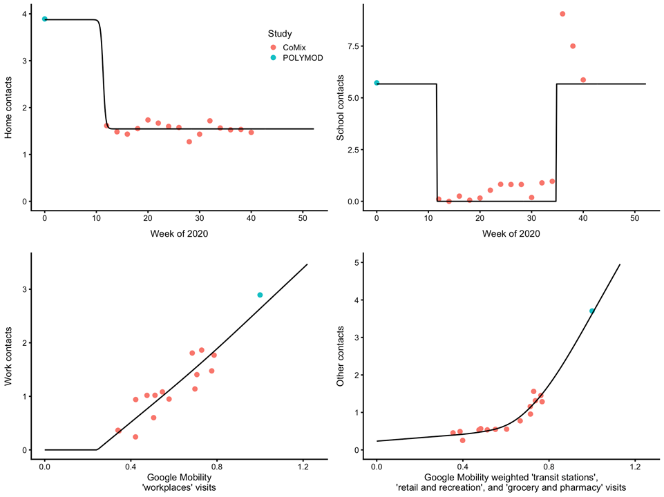
Comparison of Google Mobility data to contact rates (CoMix)
Home contacts and school contacts followed a clear pattern over time. Home contacts have not changed much since March, while school contacts follow when schools have been open or closed.

Slide 19
Comparison of Google Mobility data to contact rates (CoMix)
Home contacts and school contacts followed a clear pattern over time. Home contacts have not changed much since March, while school contacts follow when schools have been open or closed.
Workplace and “other” contacts (leisure, retail, etc) have followed a more complex pattern over time (not shown), but are strongly associated with Google Mobility indices.

Slide 20
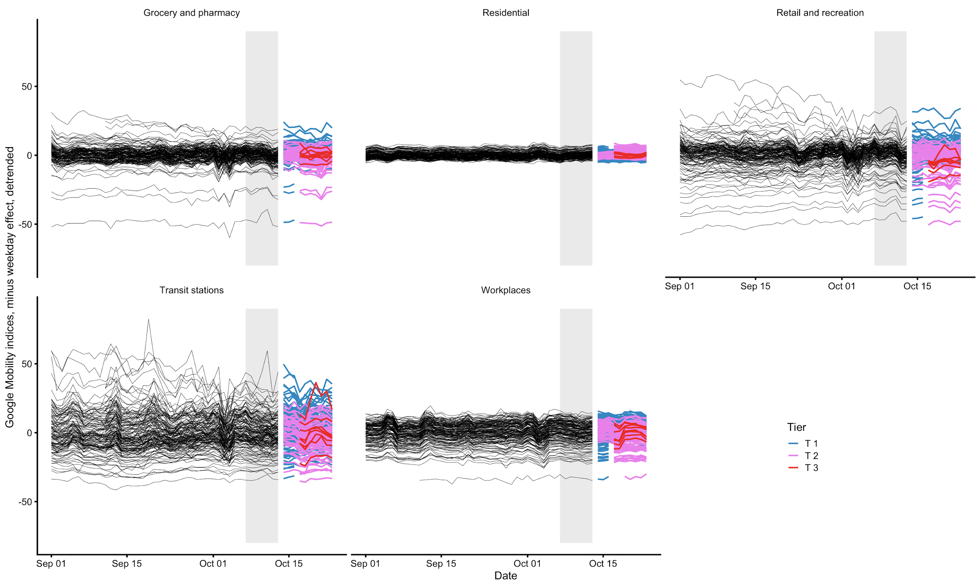
Mobility over time by Tier, as measured by Google

Slide 21
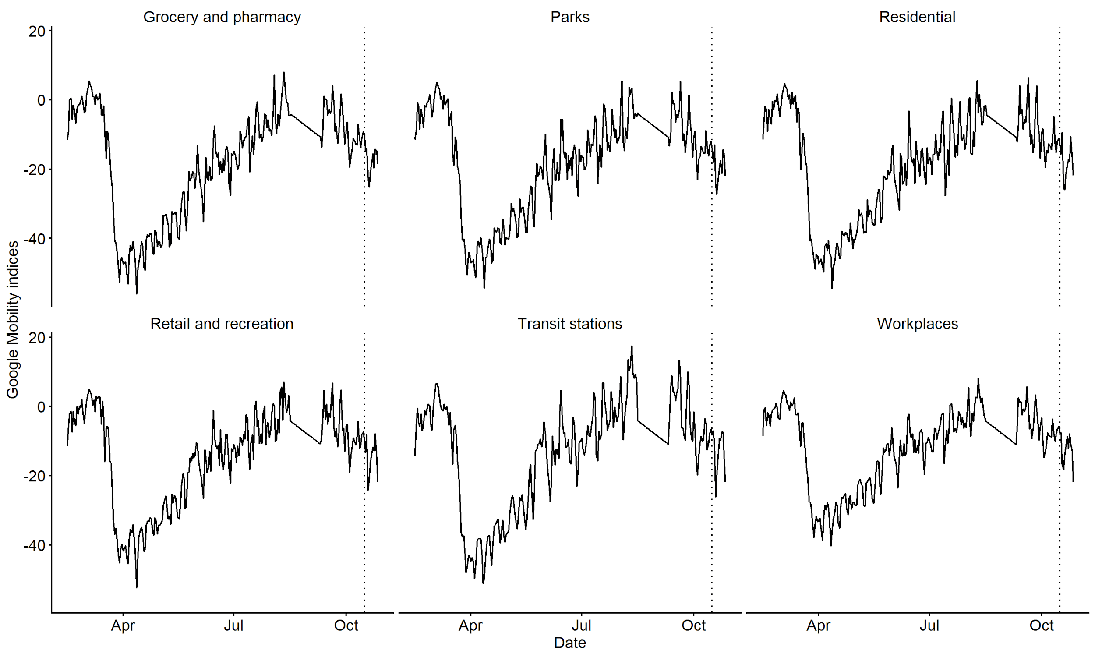
Mobility over time in Northern Ireland, as measured by Google
….. Lockdown started

Slide 22
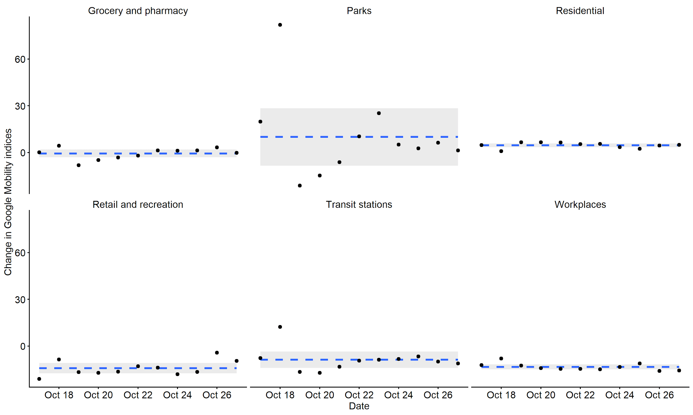
Change in mobility after lockdown in Northern Ireland
---- Mean
95% CI

Slide 23
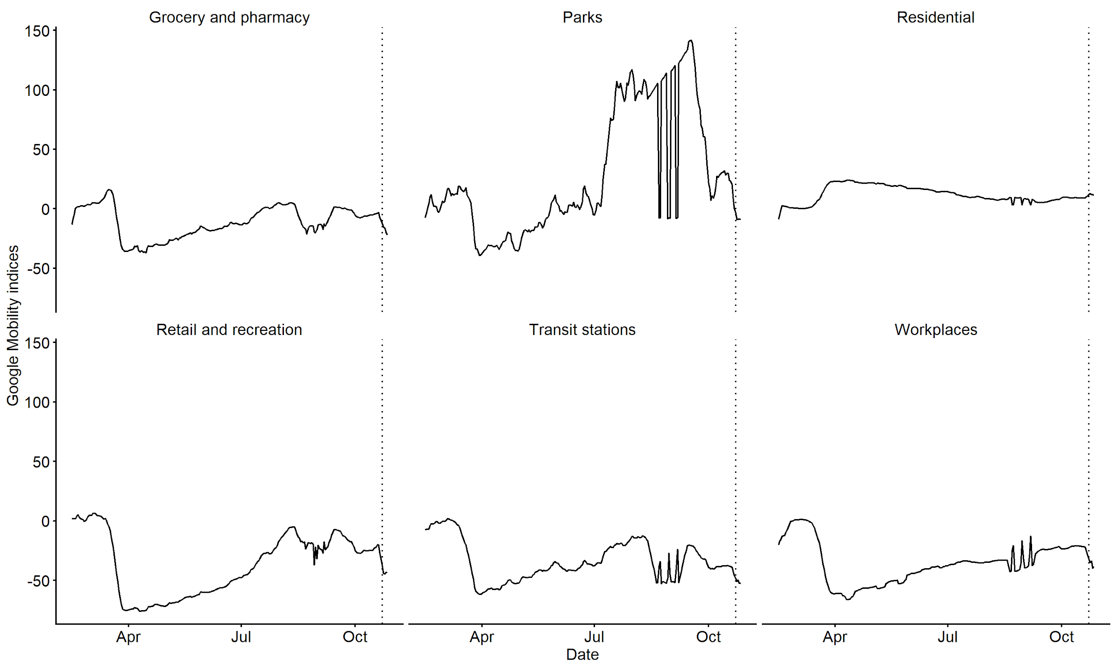
Mobility over time in Wales, as measured by Google
….. Lockdown started

Slide 24
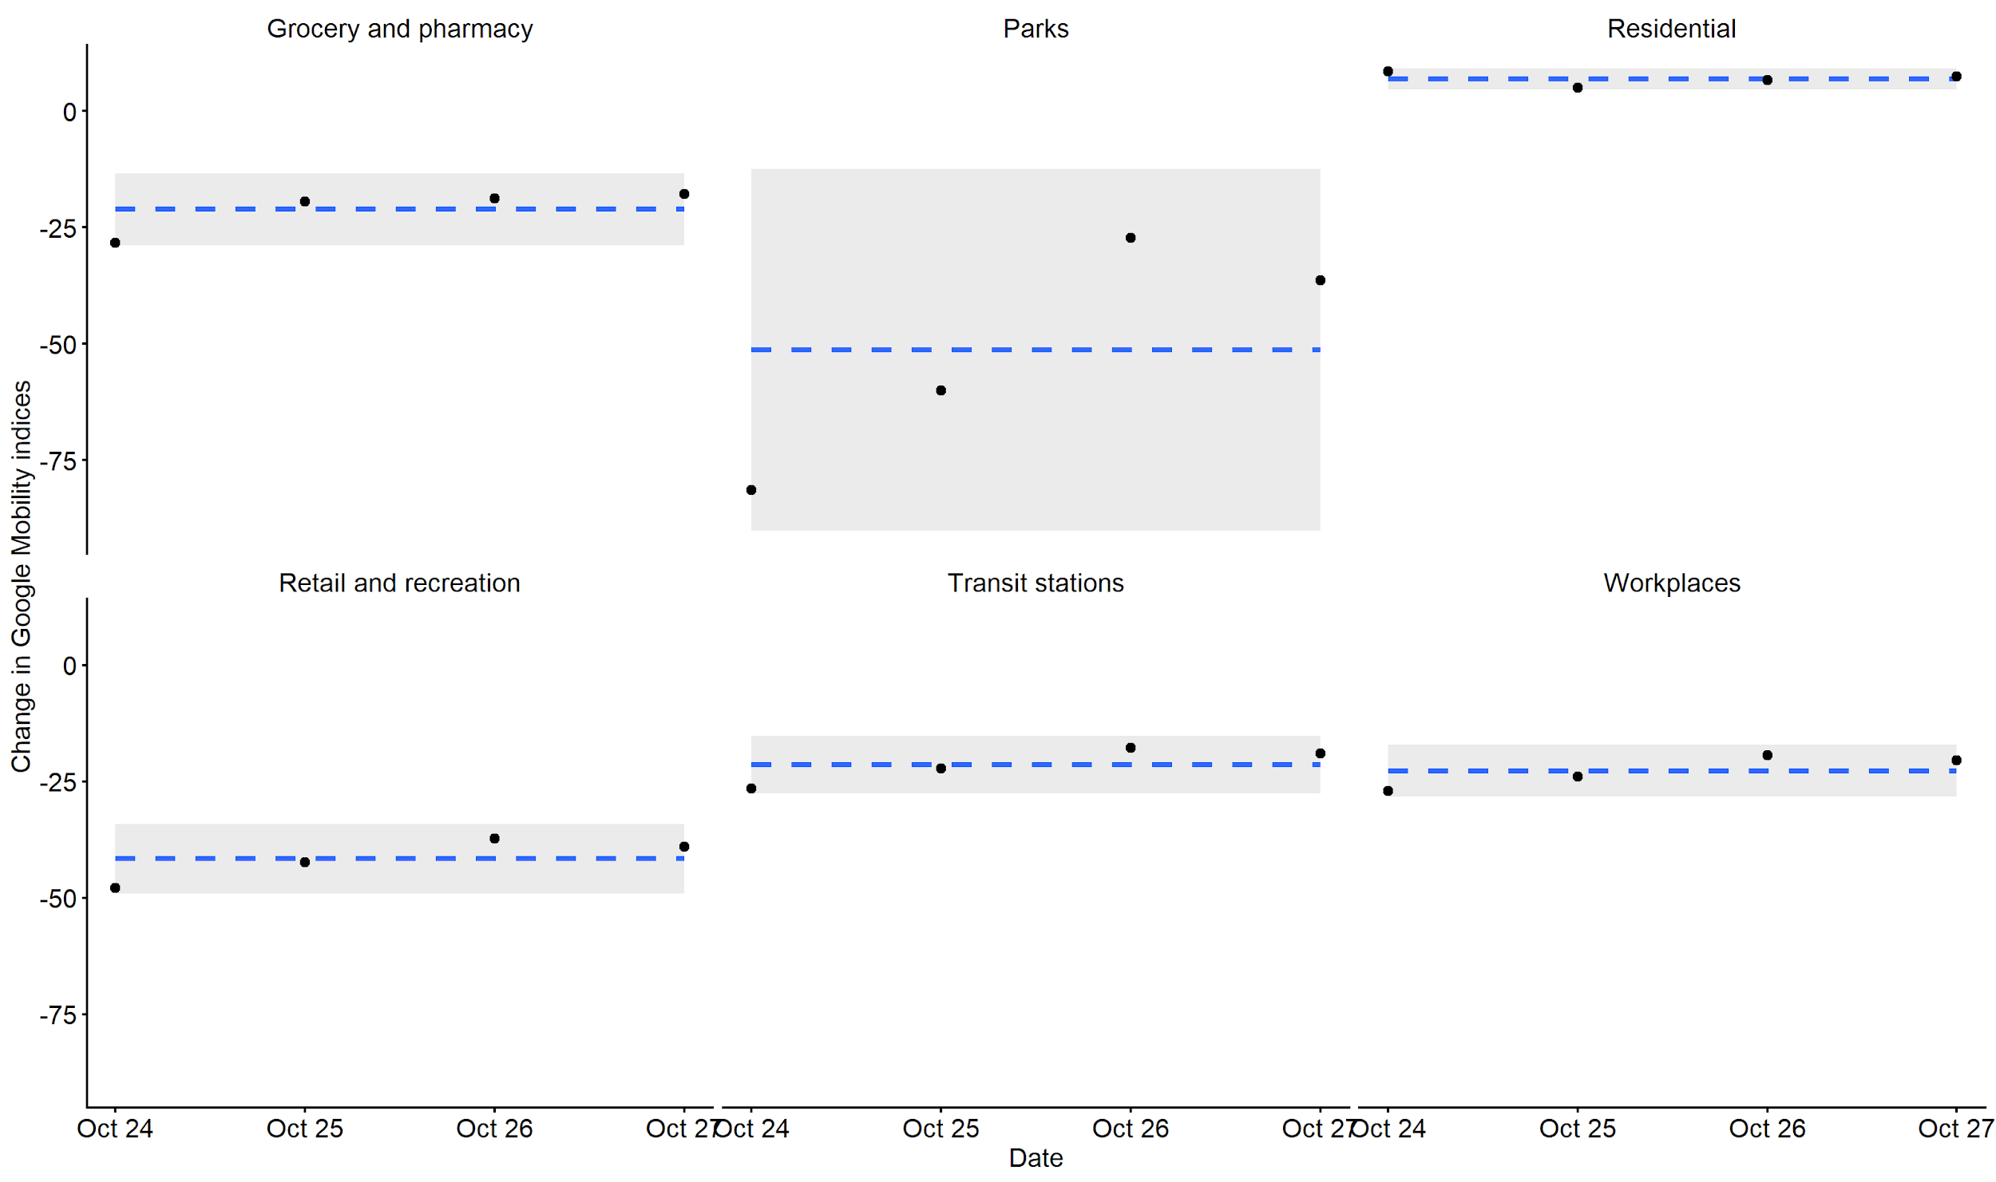
Change in mobility after lockdown in Wales
---- Mean
95% CI

Slide 25
Appendix: Summary of Welsh “firebreak” lockdown
Monday 19th October: “firebreak” lockdown announced from Friday 23rd to Monday 9th November 2020
Stay at home and work at home where possible
Indoor and outdoor gatherings with other households banned
Non-essential retail, leisure, hospitality and tourism required to close
Primary schools and years 7 and 8 in secondary schools return on Monday 2nd November
All school students return on Monday 9th November
Universities to continue providing a blend of online and in-person teaching

Slide 26
Appendix: Summary of Northern Irish “circuit breaker” lockdown
Wednesday 14th October: “circuit breaker” lockdown announced from Friday 16th October 2020 for four weeks
Avoid unnecessary travel and work from home where possible
Household bubbles limited to 10 people from 2 households
No overnight stays across households unless in a bubble
Closure of hospitality sector except for food takeaway and deliveries
Closure of close contact services such as hairdressers and beauticians except for essential health interventions and therapeutics
Schools closing from Monday 19th October and returning on Monday 2nd November
Universities and further education continue delivering distance learning with only essential face to face learning taking place

